Slide 1
(More) Web Security and Privacy COS 432: Information Security
Nick Feamster

Slide 2
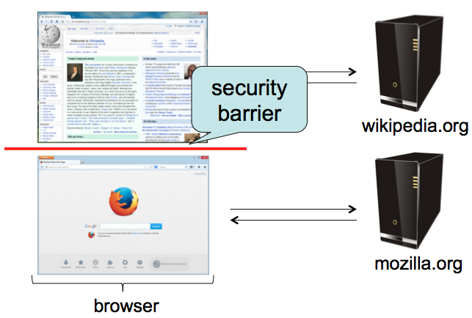
Same-Origin policy
Each site is isolated from all others

Slide 3
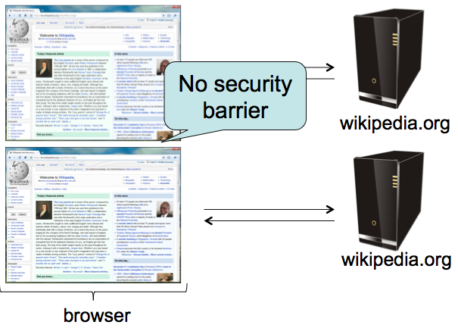
Same-Origin Policy
Multiple pages from same site aren’t isolated

Slide 4
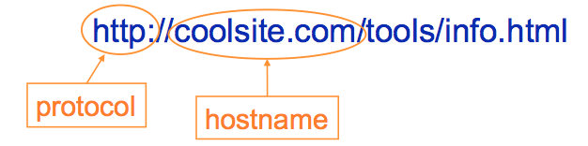
Same-Origin Policy
Granularity of protection: the origin
Origin = protocol + hostname + port
Javascript on one page can read, change, and interact freely with all other pages from the same origin

Slide 5
Same-Origin Policy
Browsers provide isolation for JS scripts via the Same Origin Policy (SOP)
Simple version:
Browser associates web page elements (layout, cookies, events) with a given origin ≈ web server that provided the page/cookies in the first place
Identity of web server is in terms of its hostname, e.g., bank.com
SOP = only scripts from a web page’s origin have access to page’s elements
XSS: Subverting the Same Origin Policy

Slide 6





Web Overview (HTTP)
GET / HTTP/1.1 Host: gmail.com
HTTP/1.1 200 OK … <html>
<head>
<script>alert(‘Hi!’)</script>
</head>
<img src=“//gmail.com/img.png”/>
http://gmail.com/ says: Hi!
gmail.com
GET /img.png HTTP/1.1 Host: gmail.com
HTTP/1.1 200 OK … <89>PNG^M ...
Notes:
Fetching image, not script

Slide 7

AJAX (jQuery Style)
GET / HTTP/1.1 Host: gmail.com
HTTP/1.1 200 OK …
<script> $.get(‘http://gmail.com/msgs.json’, function (data) { alert(data) }); </script>
http://gmail.com/ says: { new_msgs: 3}
gmail.com
$.get(‘http://gmail.com/msgs.json’, function (data) { alert(data) });
GET /msgs.json HTTP/1.1 Host: gmail.com
HTTP/1.1 200 OK … { new_msgs: 3 }
Notes:
Fetching and executing script from same origin

Slide 8



Same-Origin Policy: Scripts
(evil!) facebook.com
GET / HTTP/1.1 Host: facebook.com
HTTP/1.1 200 OK … <script> $.get(‘http://gmail.com/msgs.json’,
function (data) { alert(data); }
</script>
$.get(‘http://gmail.com/msgs.json’,
function (data) { alert(data); }
GET /msgs.json HTTP/1.1 Host: gmail.com
gmail.com
HTTP/1.1 200 OK … { new_msgs: 3 }
Notes:
Trying to execute script from different origin.
XMLHttpRequest cannot load https://gmail.com/. No 'Access-Control-Allow-Origin' header is present on the requested resource. Origin 'null' is therefore not allowed access.

Slide 9
Same-Origin Policy: Objects
GET / HTTP/1.1 Host: facebook.com
facebook.com
HTTP/1.1 200 OK … <img src=“http://gmail.com/img.png”/>
?
gmail.com
Notes:
Not a script, just an image: OK.

Slide 10

Same-Origin Policy: Images
GET / HTTP/1.1 Host: facebook.com
facebook.com
HTTP/1.1 200 OK … <img src=“http://gmail.com/img.png”/>
GET /img.png HTTP/1.1 Host: gmail.com
gmail.com
HTTP/1.1 200 OK … <89>PNG^M ...
Notes:
XMLHttpRequest cannot load https://gmail.com/. No 'Access-Control-Allow-Origin' header is present on the requested resource. Origin 'null' is therefore not allowed access.

Slide 11
Same-Origin Policy: <script>
GET / HTTP/1.1 Host: facebook.com
facebook.com
HTTP/1.1 200 OK … <script src=“http://gmail.com/chat.js”/>
?
gmail.com
Notes:
XMLHttpRequest cannot load https://gmail.com/. No 'Access-Control-Allow-Origin' header is present on the requested resource. Origin 'null' is therefore not allowed access.

Slide 12

Same-Origin Policy: <script>
GET / HTTP/1.1 Host: facebook.com
facebook.com
HTTP/1.1 200 OK … <script src=“http://gmail.com/chat.js”/>
$.get(‘http://gmail.com/chat.json’, function (data) { alert(data); })
GET /chat.js HTTP/1.1 Host: gmail.com
gmail.com
HTTP/1.1 200 OK … $.get(‘http://gmail.com/chat.json’, function (data) { alert(data); })
Notes:
XMLHttpRequest cannot load https://gmail.com/. No 'Access-Control-Allow-Origin' header is present on the requested resource. Origin 'null' is therefore not allowed access.

Slide 13
Same-Origin Policy: <script>
gmail.com
$.get(‘http://gmail.com/chat.json’, function (data) { alert(data); })
GET /chat.json HTTP/1.1 Host: gmail.com
HTTP/1.1 200 OK … { new_msg: { from: “Bob”, msg: “Hi!”}}
Notes:
XMLHttpRequest cannot load https://gmail.com/. No 'Access-Control-Allow-Origin' header is present on the requested resource. Origin 'null' is therefore not allowed access.

Slide 14
Same-Origin Policy: IFrame
GET / HTTP/1.1 Host: facebook.com
facebook.com
HTTP/1.1 200 OK … <iframe src=“http://gmail.com/chat”/>
?
gmail.com
Notes:
XMLHttpRequest cannot load https://gmail.com/. No 'Access-Control-Allow-Origin' header is present on the requested resource. Origin 'null' is therefore not allowed access.

Slide 15

Same-Origin Policy: IFrame
GET / HTTP/1.1 Host: facebook.com
facebook.com
$.get(‘http://gmail.com/chat.json’, function (data) { alert(data); })
HTTP/1.1 200 OK … <iframe src=“http://gmail.com/chat”/>
GET /chat HTTP/1.1 Host: gmail.com
gmail.com
HTTP/1.1 200 OK … <script> $.get(‘http://gmail.com/chat.json/’, function (data) { alert(data); }); </script>
Notes:
XMLHttpRequest cannot load https://gmail.com/. No 'Access-Control-Allow-Origin' header is present on the requested resource. Origin 'null' is therefore not allowed access.

Slide 16
Same-Origin Policy
http://gmail.com/ says: { new_msgs: { from: “Bob”, msg: “Hi!”}}
gmail.com
$.get(‘http://gmail.com/chat.json’, function (data) { alert(data); })
GET /chat.json HTTP/1.1 Host: gmail.com
HTTP/1.1 200 OK … { new_msg: { from: “Bob”, msg: “Hi!”}}
Notes:
XMLHttpRequest cannot load https://gmail.com/. No 'Access-Control-Allow-Origin' header is present on the requested resource. Origin 'null' is therefore not allowed access.

Slide 17
Cross-site Request Forgery (CSRF)
fde874 = bob
Suppose you log in to bank.com
POST /login?user=bob&pass=abc123 HTTP/1.1 Host: bank.com
bank.com
HTTP/1.1 200 OK Set-Cookie: login=fde874 ….

Slide 18
Cross-site Request Forgery (CSRF)
fde874 = bob
GET /account HTTP/1.1 Host: bank.com
Cookie: login=fde874
bank.com
HTTP/1.1 200 OK ….
$378.42

Slide 19
Cross-site Request Forgery (CSRF)
fde874 = bob
Click me!!! http://bank.com/transfer?to=badguy&amt=100
GET /transfer?to=badguy&amt=100 HTTP/1.1 Host: bank.com
Cookie: login=fde874
bank.com
HTTP/1.1 200 OK ….
Transfer complete: -$100.00

Slide 20
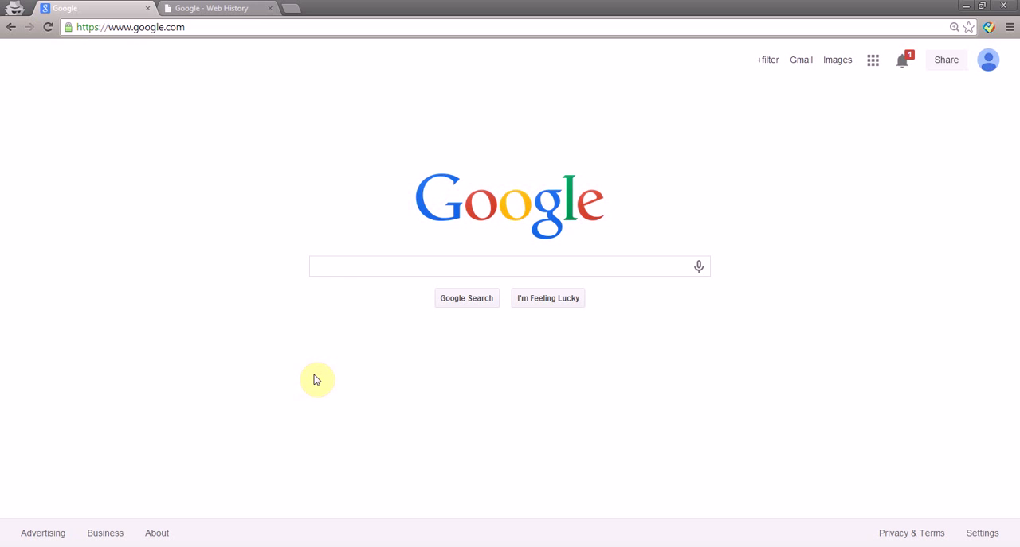
Profile Pollution with CSRF
Take This Personally: Pollution Attacks on Personalized Services. X. Xing, W. Ming, D. Doozan, A. Snoeren, N. Feamster, W. Lee. In USENIX Security Symposium, 2013.

Slide 21
CSRF Defenses
Need to “authenticate” each user action originates from our site
One way: each “action” gets a token associated with it
On a new action (page), verify the token is present and correct
Attacker can’t find token for another user, and thus can’t make actions on the user’s behalf

Slide 22
CSRF Defenses
Pay $25 to Joe: http://bank.com/transfer?to=joe&amt=25&token=8d64
fde874 = bob
<input type="hidden" name=”token" value="8d64" />
HTTP/1.1 200 OK Set-Cookie: token=8d64 ….
bank.com
GET /transfer?to=joe&amt=25&token=8d64 HTTP/1.1 Host: bank.com
Cookie: login=fde874
HTTP/1.1 200 OK ….
Transfer complete: -$25.00

Slide 23
Same-Origin Policy
Origin | Trying to access | Allowed?
http://example.com/a/ | https://example.com/ | Protocol mismatch
http://example.com/a/ | http://example.com/b/ | Yes
http://example.com/ | http://www.example.com/a/ | Host mismatch
http://example.com:81/ | http://example.com/ | Port mismatch
Notes:
SOP answers the question “Can a script with an origin X access a resource loaded from origin Y?”
In a nutshell, X and Y should be “the same.” The slide answers what it means for X and Y to be the same.

Slide 24
What about externally hosted scripts?
Say example.com loads the following JS
<script src="//ajax.googleapis.com/ajax/ libs/jquery/1.10.2/jquery.min.js">
</script>
Can it function normally in spite of SOP?
Yes. The origin of this script is still example.com
Notes:
It looks like if example.com incorporates an externally hosted script (here coming from ajax.googleapis.com) then it won’t be able to function properly because it can’t read example.com cookies.
What’s going on here?
Answer: origins apply to pages and iFrames. They don’t apply at a per-object level. The definition doesn’t care about which domain the script came from. Here the script’s origin is still example.com because that’s the page that did the loading.

Slide 25
SOP Complications
Subtly different policies for
Cookies
HTML5 storage
Plugins
Ambiguities: different browsers, extensions, IP addresses…

Slide 26
Other problems with SOP
Hostnames not an accurate way to define trust boundaries
webhost.com/~alice vs webhost.com/~bob
login.example.com vs payments.example.com
Notes:
No way to fix the first problem
But the second can be fixed. See next slide

Slide 27
Cross-Site Scripting (XSS)
<?php
echo “Hello, ” . $_GET[“user”] . “!”;
GET /?user=Bob HTTP/1.1
HTTP/1.1 200 OK … Hello, Bob!

Slide 28
Cross-Site Scripting (XSS)
<?php
echo “Hello, ” . $_GET[“user”] . “!”;
GET /?user=<u>Bob</u> HTTP/1.1
HTTP/1.1 200 OK … Hello, <u>Bob</u>!

Slide 29
Cross-Site Scripting (XSS)
<?php
echo “Hello, ” . $_GET[“user”] . “!”;
http://vuln.com/ says: XSS
GET /?user=<script>alert(‘XSS’)</script> HTTP/1.1
HTTP/1.1 200 OK … Hello, <script>alert(‘XSS’)</script>!
Click me!!! http://vuln.com/?user=<script>alert(‘XSS’)</script>

Slide 30
Review: Same-Origin Policy
(evil!) facebook.com
GET / HTTP/1.1 Host: facebook.com
HTTP/1.1 200 OK … <script> $.get(‘http://gmail.com/msgs.json’,
function (data) { alert(data); }
</script>
GET /msgs.json HTTP/1.1 Host: gmail.com
gmail.com
HTTP/1.1 200 OK … { new_msgs: 3 }

Slide 31
Cross-Site Scripting (XSS) Attack
(evil!) facebook.com
GET / HTTP/1.1 Host: facebook.com
HTTP/1.1 200 OK … <iframe src=“http://gmail.com/?user=<script> $.get(‘http://gmail.com/msgs.json’, function (data) { alert(data); }) </script>”></iframe>
$.get(‘http://gmail.com/ msgs.json’, function (data) { alert(data); })
GET /?user=<script>$.get(‘ … </script> HTTP/1.1 Host: gmail.com
gmail.com
HTTP/1.1 200 OK … Hello, <script>$.get(‘http://gmail.com/msgs.json’, function (data) { alert(data); }) </script>

Slide 32
Cross-Site Scripting (XSS) Attack
(evil!) facebook.com
GET / HTTP/1.1 Host: facebook.com
HTTP/1.1 200 OK … <iframe src=“http://gmail.com/?user=<script> $.get(‘http://gmail.com/msgs.json’, function (data) { alert(data); }) </script>”></iframe>
http://gmail.com/ says: { new_msgs: 3 }
$.get(‘http://gmail.com/ msgs.json’, function (data) { alert(data); })
GET /msgs.json HTTP/1.1 Host: gmail.com
gmail.com
HTTP/1.1 200 OK … { new_msgs: 3 }

Slide 33
XSS Defenses
Make sure data gets shown as data, not executed as code!
Escape special characters
Which ones? Depends what context your $data is presented
Inside an HTML document? <div>$data</div>
Inside a tag? <a href=“http://site.com/$data”>
Inside Javascript code? var x = “$data”;
Make sure to escape every last instance!
Frameworks can let you declare what’s user-controlled data and automatically escape it

Slide 34
Web Privacy

Slide 35
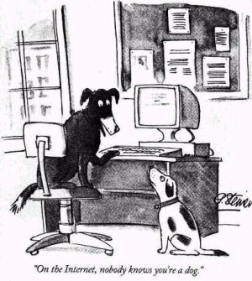
It’s the Internet! Of course they know you’re a dog. They also know your favorite brand of pet food and the name of the cute poodle at the park you have a crush on!
Notes:
Imagine if this cartoon from 1993 were published today…

Slide 36
“Third party” Online Tracking
Sites other than the one you’re visiting
typically invisible
compiling profiles of your browsing history

Slide 37
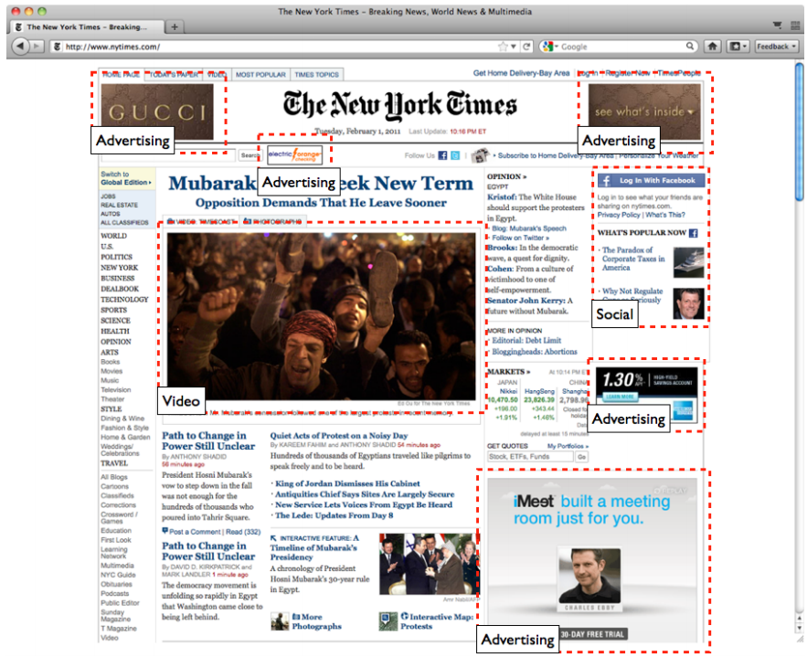
GET http://youtube.com/watch?v=gHStnhGxlP
Cookie: id=35c192bcfe0000b1...
Referer: http://www.nytimes.com/
Notes:
Screenshot is from a 2012 study of third-party online tracking https://cyberlaw.stanford.edu/files/publication/files/trackingsurvey12.pdf
Notice all the red boxes: Typically this content is not served by the NYT. There are a lot more trackers that are invisible.
The combination of cookie and referer is what enables third-party tracking.
Funny aside: the HTTP protocol misspells referrer as referer. It’s part of the protocol specification so it can’t be changed.

Slide 38
What if User Blocks Referer?
GET http://youtube.com/watch?v=gHStnhGxlP
Cookie: id=35c192bcfe0000b1...
Referer: http://www.nytimes.com/
Read page URL using JavaScript? (top.location.href)
Yes, but not if inside iframe
Notes:
It’s not very easy to prevent the ability to track. One try is to block the referer header, but third-party JavaScript can read it anyway, unless it’s in an iFrame.

Slide 39
Cooperative Tracking
http://firstparty.com
GET http://tracker.com/?from=firstparty.com
Referer: http://firstparty.com/
Cookie: id=35c192bcfe0000b1...
http://tracker.com/…
Notes:
Co-operative tracking is particularly hard to prevent --- here the first party tells the third party the referring URL.

Slide 40
64
Independent tracking mechanisms on typical top-50 sites

Slide 41
Who are the Third Parties?
Some prominent trackers:
Facebook
Google
bluekai.com
revsci.net
112.2o7.net
Notes:
Think about why these entities are in the business of tracking. You might want to look up some of these and which companies they belong to.

Slide 42


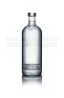




What is Behavioral Targeting?
Ad Network
Advertisers
Publishers
Notes:
Profiles based on user’s past activity help ad networks serve targeted ads based on real-time ad auctions.

Slide 43
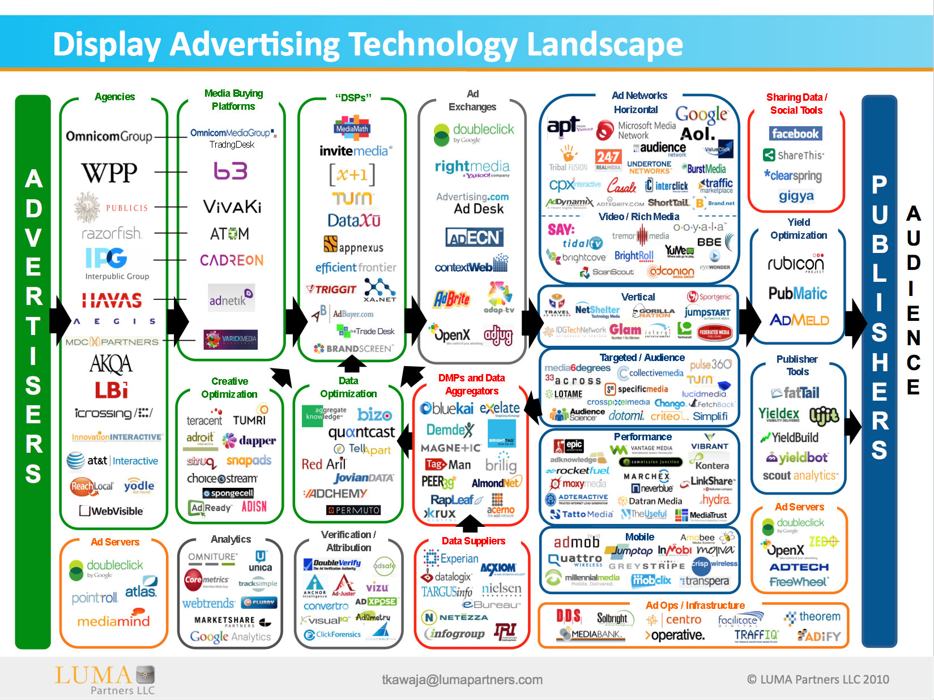

Slide 44
Privacy Worries
Intellectual privacy
Behavioral targeting
Price discrimination
NSA
Notes:
NSA piggybacks on ad cookies for surveillance and delivering exploits: https://www.washingtonpost.com/news/the-switch/wp/2013/12/10/nsa-uses-google-cookies-to-pinpoint-targets-for-hacking/

Slide 45
Tracking Techniques

Slide 46
Tagging: Placing Data in the Browser
HTTP Cookies
HTTP Auth
HTTP Etags
Content cache
IE userdata
HTML5 protocol & content handlers
HTML5 Storage
Flash cookies
Silverlight storage
TLS session ID & resume
Browsing history
window.name
HTTP STS
DNS cache
Notes:
The point of this slide is that numerous web APIs allow placing data in the browser, directly or indirectly, and all of these can be used for uniquely identifying the user and hence tracking their browsing

Slide 47
Exploiting STS for Tagging
HTTP Strict Transport Security:
Tells browser to use encryption when connecting to a domain → 1 tracking bit per domain
Can this somehow be used to track uniquely?!
Create (say) 64 subdomains
Each subdomain gives you 1 bit of tracking
Collectively: enough to uniquely identify every user

Slide 48
Exploiting STS for Tagging
http://firstparty.com
http://tracker.com/
a.tracker.com
1
0
1
1
0
0
1
0
…
…
…
…
…

Slide 49
Fingerprinting: Observing the Browser’s Behavior
User-Agent
HTTP ACCEPT headers
Browser plug-ins
MIME support
Clock skew
Installed fonts
Cookies enabled?
Browser add-ons
Screen resolution
Notes:
Fingerprinting is more insidious, as it leaves no trace in the browser that the user is being tracked.
Different devices/browsers will have different fingerprints based on a combination of attributes listed on this slide, and more.

Slide 50
Panopticlick – Browser Fingerpringing
Vast majority of browsers/devices have unique fingerprints (among millions of other devices)

Slide 51

Notes:
Test it out here: https://panopticlick.eff.org/
There’s a writeup of the technology here: https://panopticlick.eff.org/static/browser-uniqueness.pdf

Slide 52
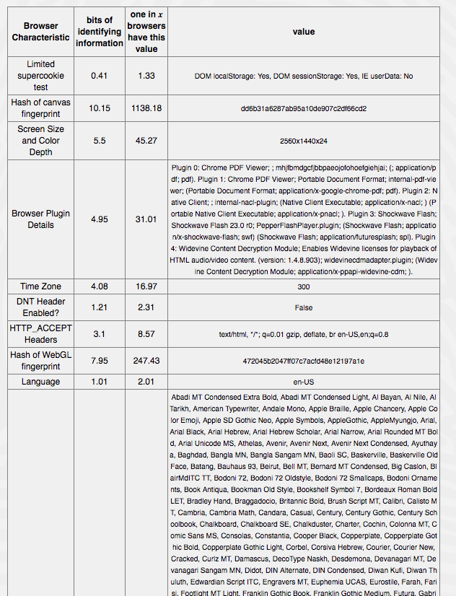

Slide 53
Anonymous Tracking? Not Quite
1. Third party is sometimes a first party

Slide 54
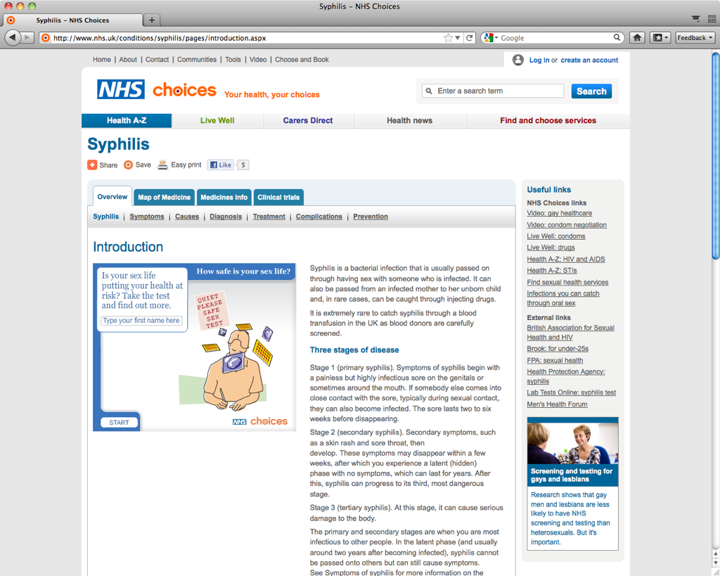
Notes:
Facebook can connect your identity with their tracking of your browsing through the Like button

Slide 55
Anonymous Tracking? Not Quite
2. Leakage of identifiers
GET http:/​/ad.doubleclick.net/adj/... Referer: http:/​/submit.SPORTS.com/...?email=jdoe@email.com Cookie: id=35c192bcfe0000b1...
Notes:
Slide shows a request to a third-party resource embedded on a page (in this case sports.com). This is a result of careless programming: the referer header leaks your identity.
Search terms also frequently leak to third parties.

Slide 56
Merging Across Distinct Databases
Different trackers have different IDs for the user
Different IDs on different devices of the same user
Retail trackers have offline databases
Linking across any of these boundaries is possible.

Slide 57
Cookie Synchronization
Tracker X knows a user U by the id x
Tracker Y knows a user U by the id y
How can X & Y link x & y in their databases?
Hint: this must happen via the browser when user visits a site with either X or Y embedded
Notes:
For example, cookie syncing allows linking different IDs that different trackers have assigned to the same user (first bullet in previous slide.)
Other linking techniques: onboarding (online--offline), cross-device tracking (different devices belonging to same user).

Slide 58
http://firstparty.com
GET http://trackerY.com/?uid=xxxxxxx
Referer: http://trackerX.com/…
Cookie: id=yyyyyyy
http://trackerX.com/…
http://trackerY.com/…
redirect
Notes:
TrackerX embeds its ID for the user into the GET request as a parameter

Slide 59
Defenses

Slide 60
1. Referer Blocking
Two drawbacks
Blocking referer indiscriminately will break many sites

Slide 61
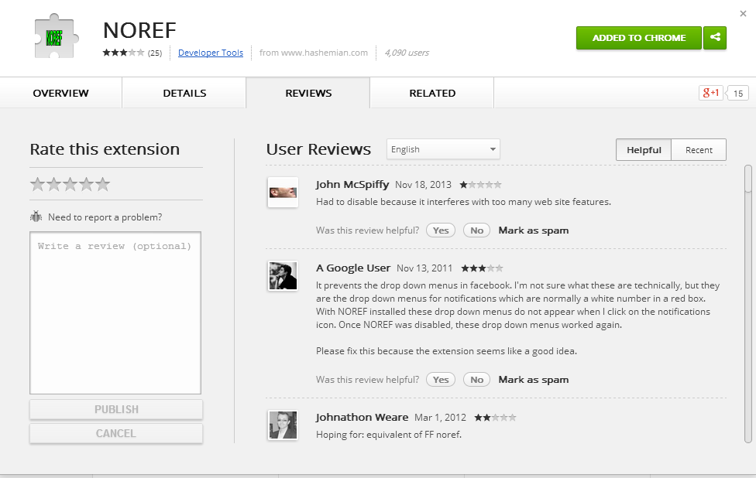
Notes:
Note complaints about breakage for this referer-blocking extension

Slide 62
1. Referer blocking
Two drawbacks
Many sites check referer header for XSRF defense Blocking referer indiscriminately will break sites
Can’t prevent cooperative tracking

Slide 63
Third-party Cookie Blocking
Relatively little breakage, but…
Doesn’t prevent fingerprinting

Slide 64
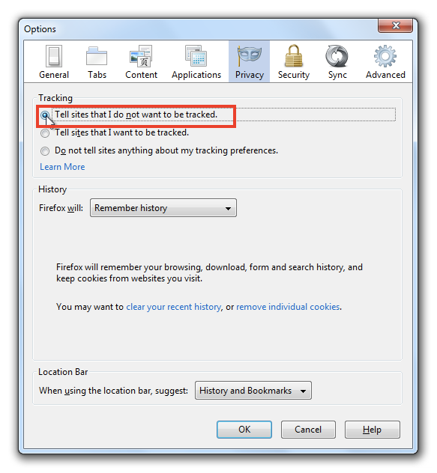
Do Not Track
Notes:
Do Not Track signals a user’s opt-out preference with an HTTP header, a simple technology that is completely compatible with the existing web. While some third parties have committed to honor Do Not Track, many more have not. In February 2012, the major online advertising trade groups pledged at the White House to support Do Not Track by year-end; that promise remains unfulfilled. Efforts to standardize Do Not Track in the World Wide Web Consortium have resulted in deadlock, despite frequent urging by American and European policymakers.

Slide 65
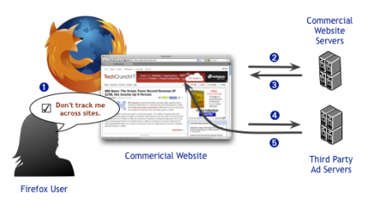
How Do Not Track is Supposed to Work
Notes:
The idea is to give users a universal way to opt-out of all third-party tracking. Single checkbox in browser, preference is communicated to all sites via HTTP header.
Very few sites respect Do Not Track, absent regulatory or commercial pressures.

Slide 66
HTTP Request Blocking
Compile and maintain a big list of known trackers
Semi-automated analysis
Based on domains and regular expressions
User installs browser extension
Downloads list
Blocks requests to objects on the list
Drawbacks:
False positives and negatives
Need to trust list
Notes:
This is by far the most successful approach so far.

Slide 67

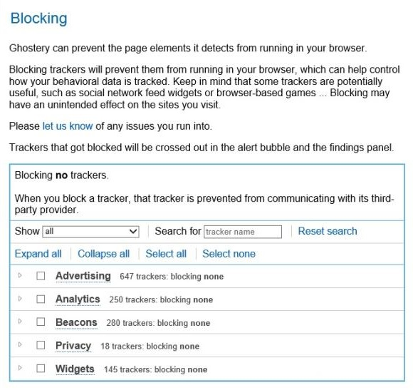

Blocking tools
AdBlock Plus
Ghostery
Notes:
AdBlock plus: need to install blocklist separately (e.g. EasyPrivacy) to block all trackers like analytics and social widgets.
There are tradeoffs. E.g., there is some breakage.
Exercise: if trackers wanted to avoid being blocked by these tools, how would they do it? If an arms race develops, which side has the advantage?

